Slide 1
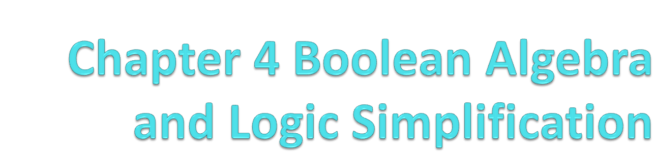

Slide 2
4.1 Boolean Operations and Expressions
Variable: a symbol used to represent a logical quantity;
Complement: the inverse of a variable
  Be indicated by a bar over the variable: NOT operation
Boolean Addition: OR operation
Boolean Multiplication: equivalent to the AND operation.

Slide 3
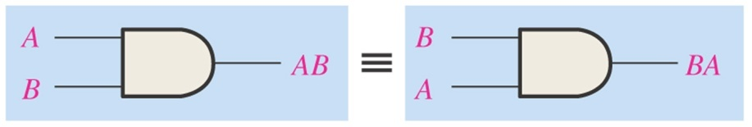
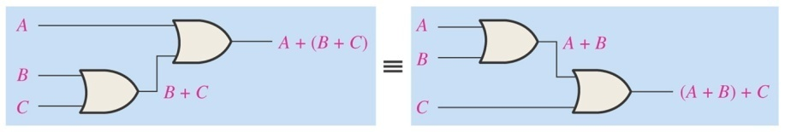
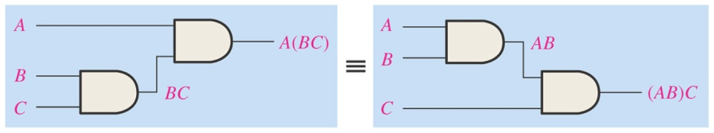
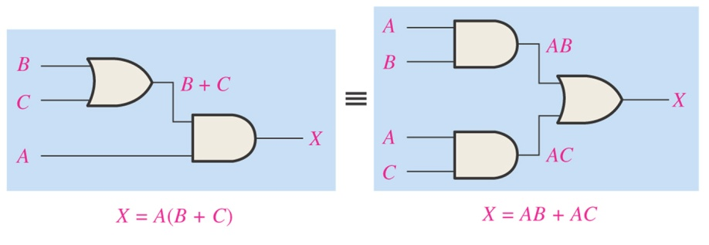
4.2 Laws and Rules of Boolean Algebra
Laws of Boolean Algebra
  Commutative Laws
    A+B=B+A
    AB=BA
  Associative Laws
    A+(B+C)=(A+B)+C
    A(BC)=(AB)C
  Distributive Law
    A(B+C)=AB+AC

Slide 4
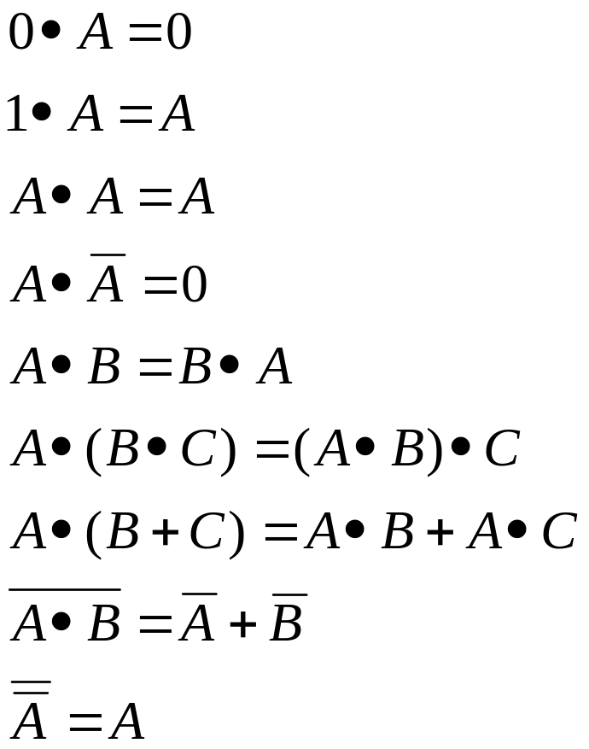
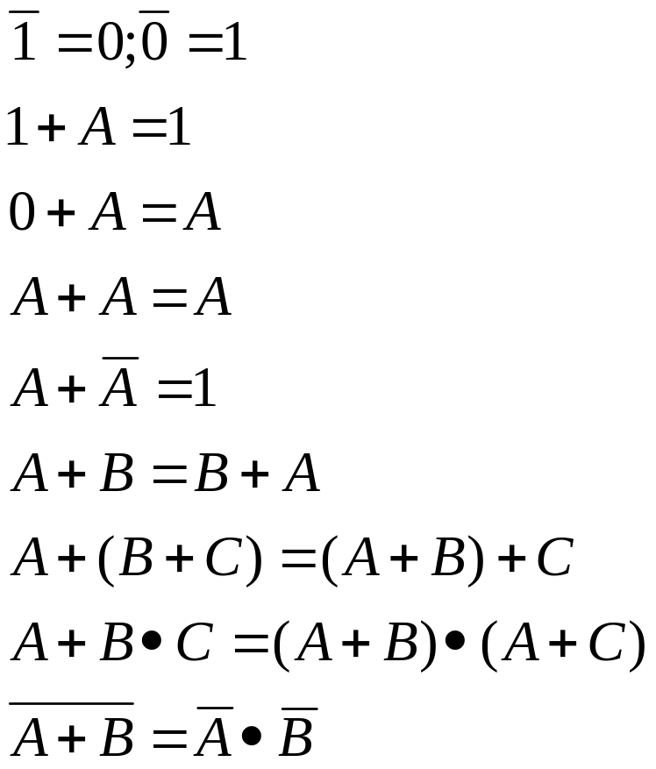
Rules of Boolean Algebra

Slide 5
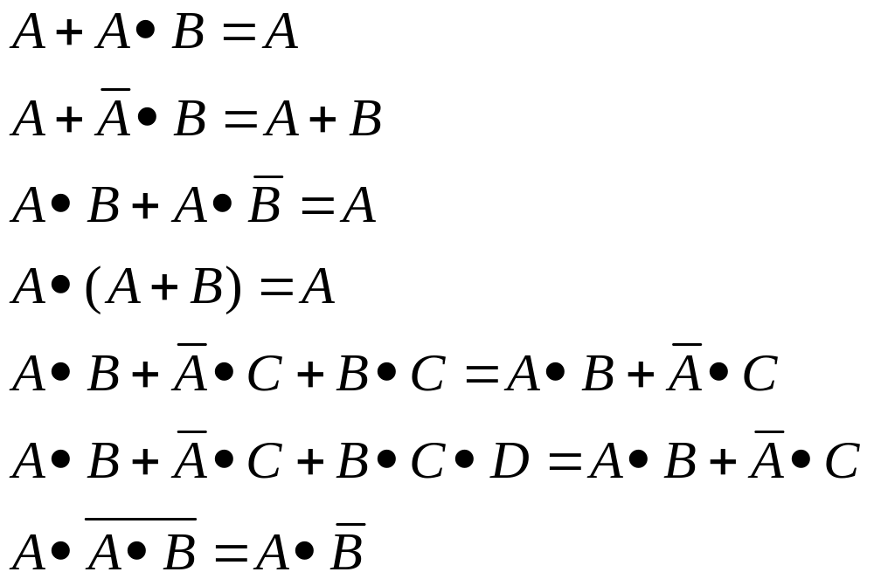

Slide 6
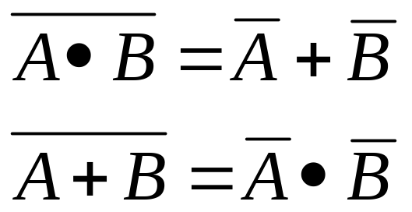
4.3 Demorgan’s Theorems
The complement of a product of variables is equal to the sum of the complements of the variables
The complement of a sum of variables is equal to the product of the complements of the variables

Slide 7
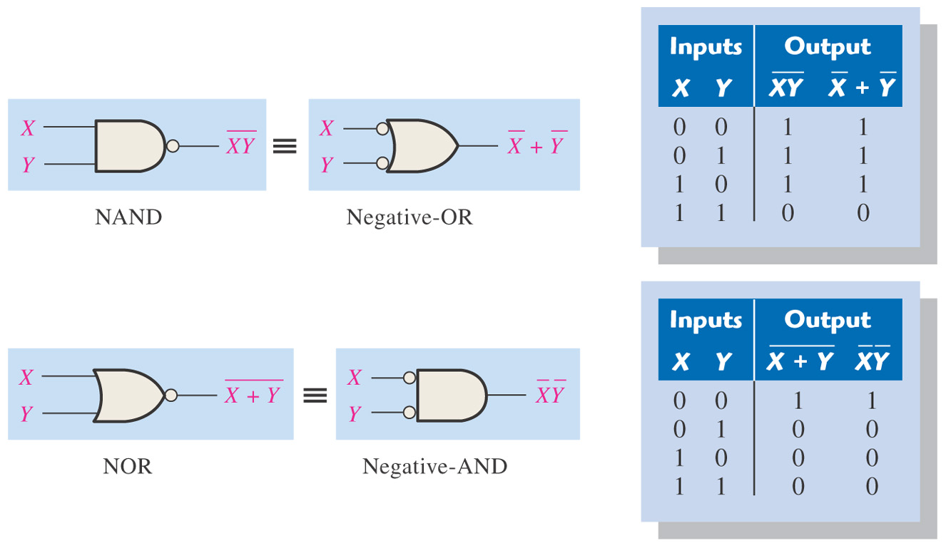
Figure 4–15 Gate equivalencies and the corresponding truth tables that illustrate DeMorgan’s theorems. Notice the equality of the two output columns in each table. This shows that the equivalent gates perform the same logic function.

Slide 8
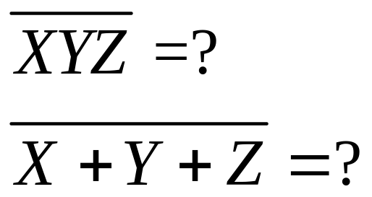
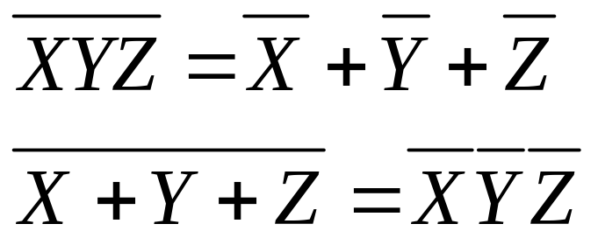
Example: Apply DeMorgan’s theorems to the following expressions

Slide 9
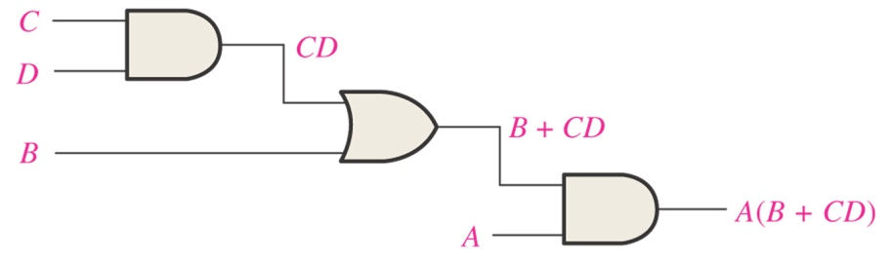
4.4 Boolean Analysis of Logic Circuits
Boolean Expression for a Logic Circuit
Constructing a Truth Table for a Logic Circuit
A | B | C | D | A(B+CD)
0 | 0 | 0 | 0 | 0
0 | 0 | 0 | 1 | 0
0 | 0 | 1 | 0 | 0
0 | 0 | 1 | 1 | 0
0 | 1 | 0 | 0 | 0
0 | 1 | 0 | 1 | 0
0 | 1 | 1 | 0 | 0
0 | 1 | 1 | 1 | 0
1 | 0 | 0 | 0 | 0
1 | 0 | 0 | 1 | 0
1 | 0 | 1 | 0 | 0
1 | 0 | 1 | 1 | 1
1 | 1 | 0 | 0 | 1
1 | 1 | 0 | 1 | 1
1 | 1 | 1 | 0 | 1
1 | 1 | 1 | 1 | 1

Slide 10
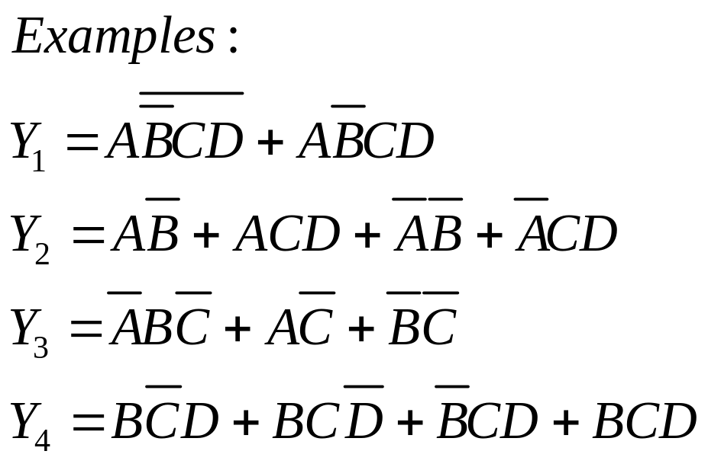
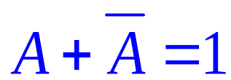
4.5 Simplification Using Boolean Algebra

Slide 11
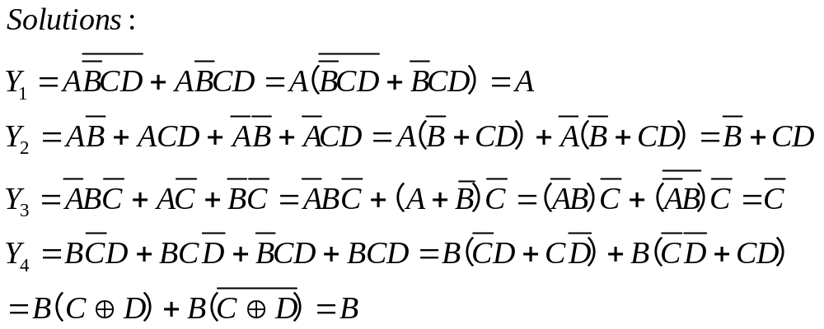

Slide 12
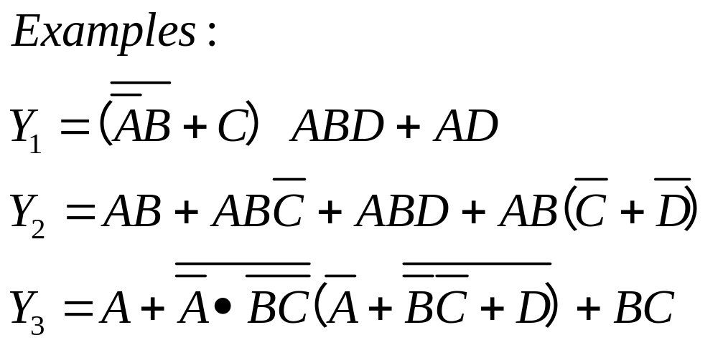
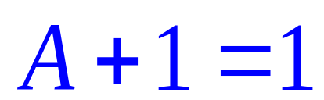

Slide 13
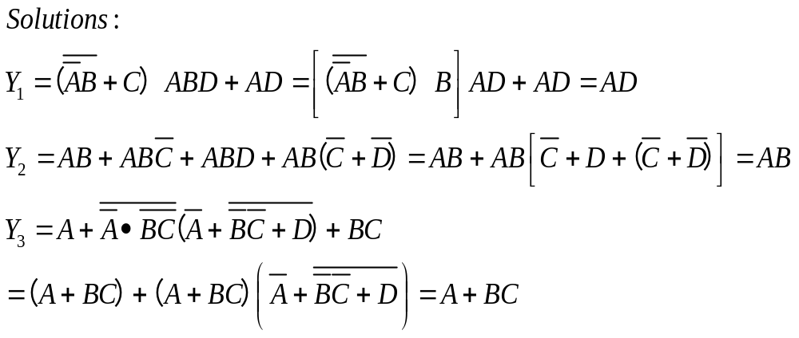

Slide 14
